Slide 1
Class DisplayImage
id_div_display_image_my_fctn_rec_x m_style_display_image clear both
id_div_display_image_my_fctn_icons style_display_image_icons clear both
id...._my_fctn_icon_four
m_style_icon
float right
id...._my_fctn_icon_three
m_style_icon
float right
id...._my_fctn_icon_two
m_style_image_icon
float right
id...._my_fctn_icon_one
m_style_..._image_icon
float right
id_div_display_image_my_fctn_picture m_style_picture clear both
group_all_texts_style_str clear both
group_left_style_str float left
group_right_style_str float left
m_style_text_one
clear both
m_style_text_three
clear both
m_style_text_two
clear both
m_style_text_four
clear both

Slide 2


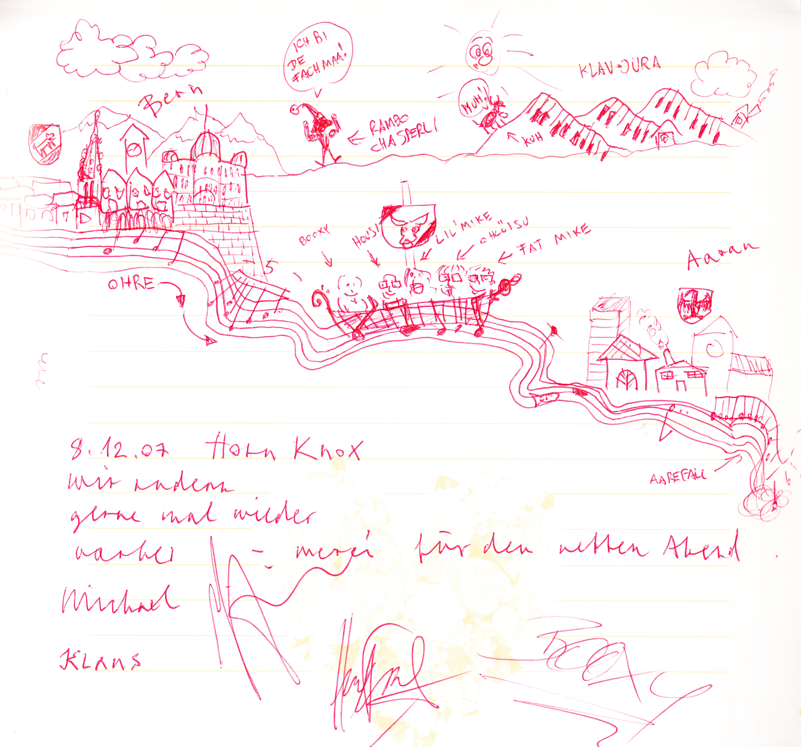
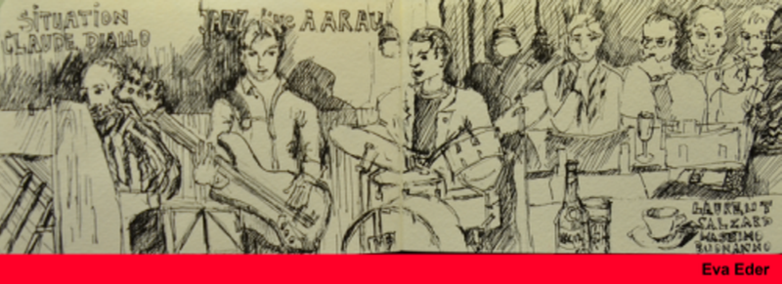
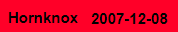
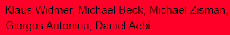
Class DisplayImage
Anything

